Slide 1
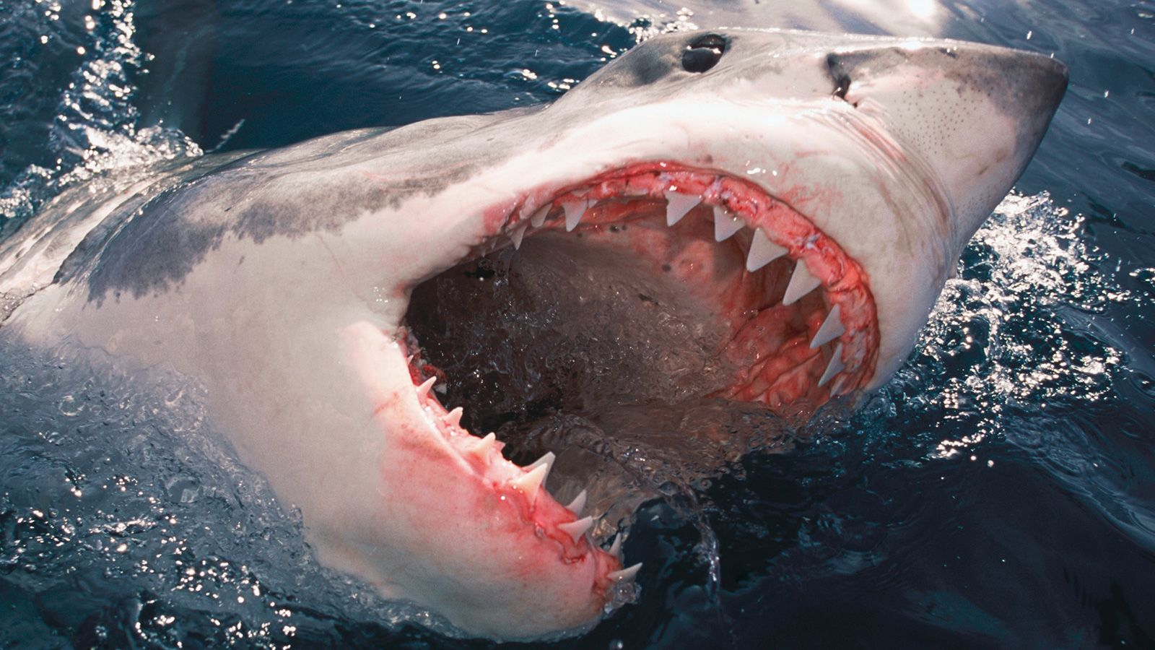
Global Sharks Attacks
Presented by:
Lyudmyla Devlysh
Kelsey Traeger
Tadeo Espinoza
Owen Phelps
Notes:
Lyuda

Slide 2
About Our Data
About Our Data
Data was retrieved from opendatasoft.com. According to their website:
Opendatasoft provides a powerful all-in-one platform for everyone to rapidly build and spread compelling data experiences.
We believe in data democratization. Everyone benefits when it is easy to share and use data-driven information in our professional and personal lives.
About this specific dataset:
All of the data on this site comes from the Global Shark Attack File (GSAF), a spreadsheet of human/shark interactions, compiled by the Shark Research Institute.
We found the data through an internet search and selected what appeared to be the most up-to-date and reliable data set about human encounters with sharks.
Coordinates from locations were obtained through the Geoapify API.
Notes:
Lyuda

Slide 3
Questions
Are there differences between sexes when it comes to shark attacks?
What activities are associated with shark attacks?
What time of day / year has the most attacks?
Where do sharks attack most frequently?
What do we really know about shark attacks?
Notes:
Lyuda

Slide 4
Analysis
Outrageous Outliers
The first reported shark attack (listed as 5 BCE): “Aboriginal rock carving depicts man being attacked by a shark”
Jackass cast member Sean McInerney (aka “Poopies”) – while filming for Shark Week on the Discovery Channel – attempted to jump a shark on a wakeboard and fell into a crowd of sharks. He was bit on the hand.
At the 1996 St. Louis Boat and Sports Show, Kathi Peters was bit by a nurse shark while swimming in a 9000 gallon tank. The name of this evil shark was Bob the Shark!
Notes:
Tadeo

Slide 5
Data Analysis Process
Clean the data
Divide the questions/topics
Clean the data some more
Analyze the data
Notes:
Owen

Slide 6
Data Exploration and Cleanup
Challenge 1
Challenge 2
Challenge 3
Data entry errors
Mistyped words, dates, and times
Inconsistent descriptions
Lots of string replacing and some categorizing of data
Finding latitude and longitude
Inconsistent location information had to be parsed and reassembled multiple ways to find reliable coordinate data
When to quit cleaning
At some point, we had to decide when to stop cleaning and to discard any remaining erroneous entries
Notes:
Owen

Slide 7
Conclusions
Cleaning data
Basic removal of bad/unreliable data
Rows with no Date, Year, or Type
Types such as: Invalid, Questionable, Unconfirmed, etc.
Lots of “replace” logic to replace badly-formatted information
Categorize times, activities, and species to account for imprecise details
Several loops over available location descriptions to try to find a Geoapify confidence level of 80% or higher for coordinates
Discard data that could not be reliably determined
Notes:
Owen

Slide 8
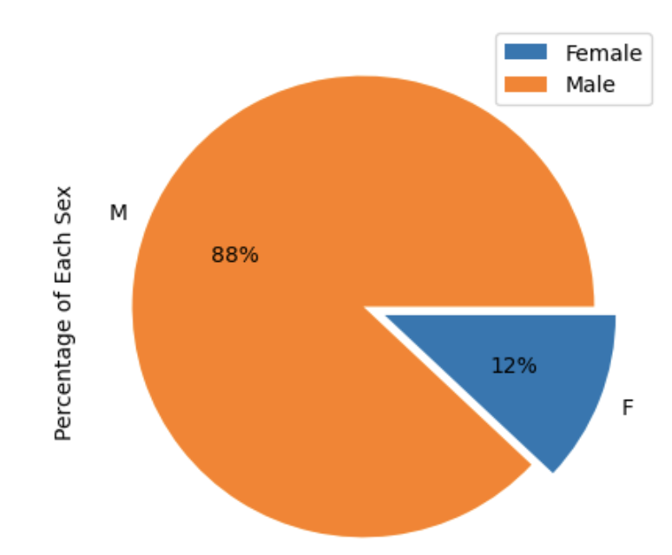
Conclusions for Sex Differences
maxgrowth
Which sex is attacked by sharks more?
Which sex provokes sharks more?
Are these findings true across countries?
Notes:
Kelsey

Slide 9
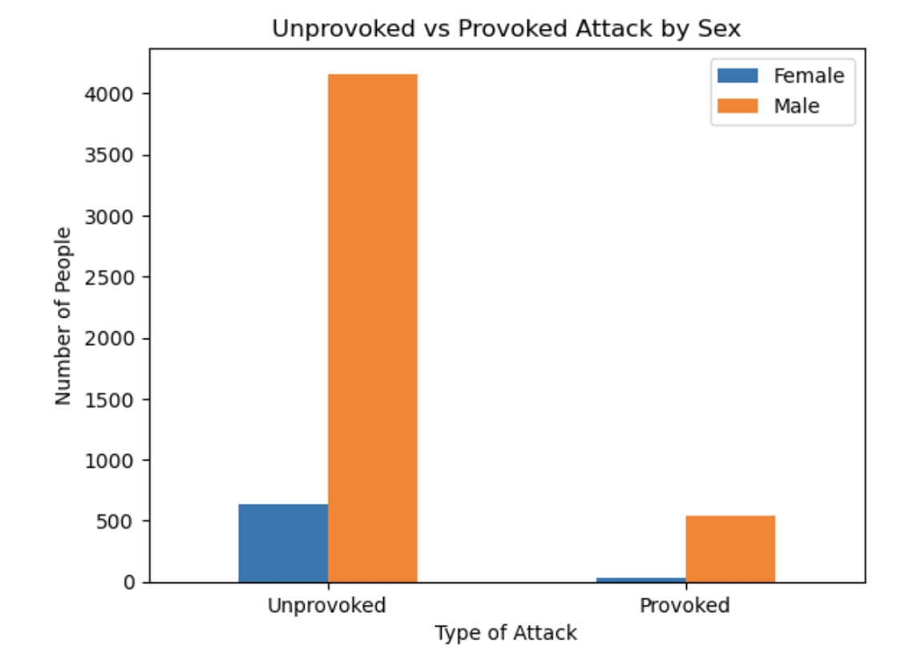
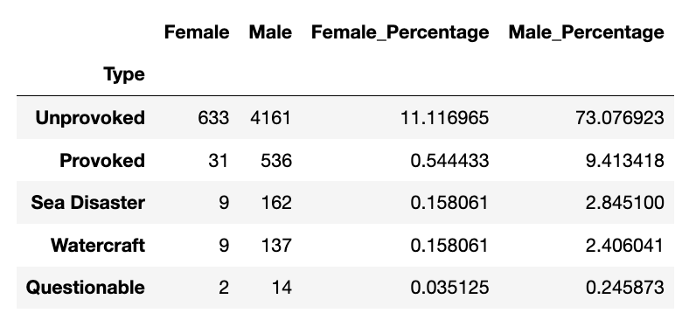
Sex Differences Across Type of Shark Attack
Notes:
Kelsey

Slide 10
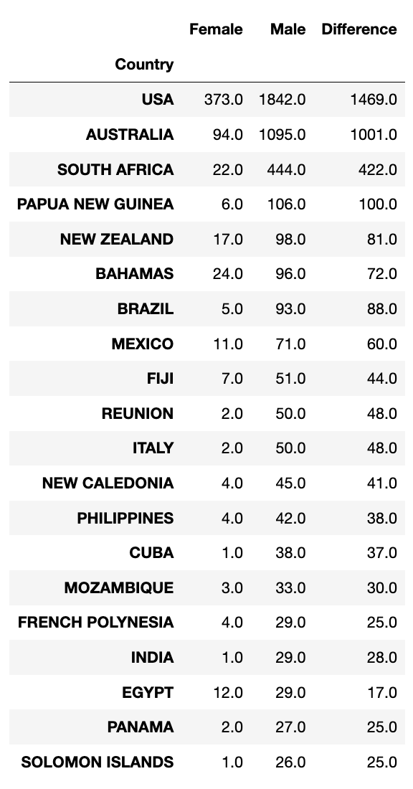
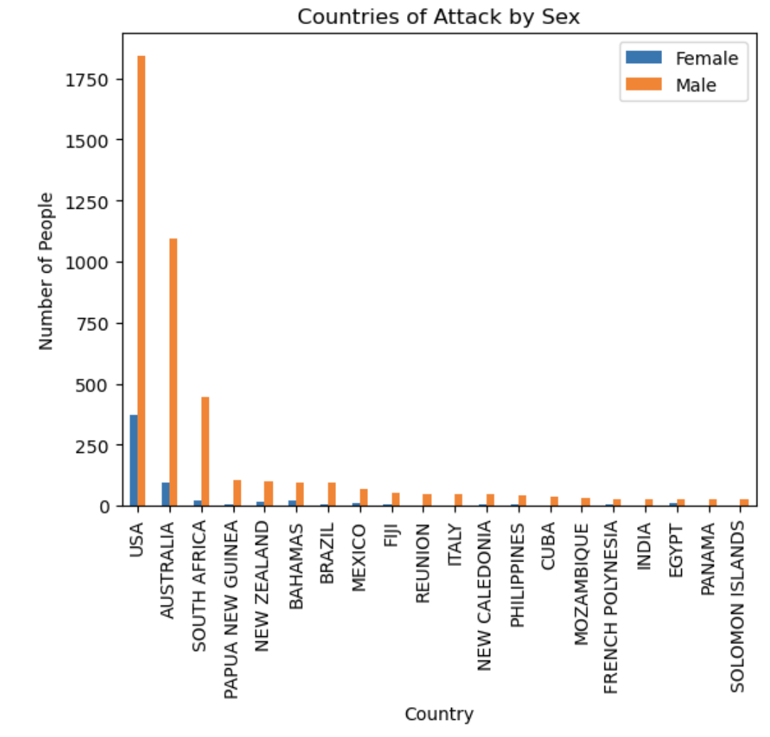
Sex differences Across Countries
Notes:
Kelsey

Slide 11
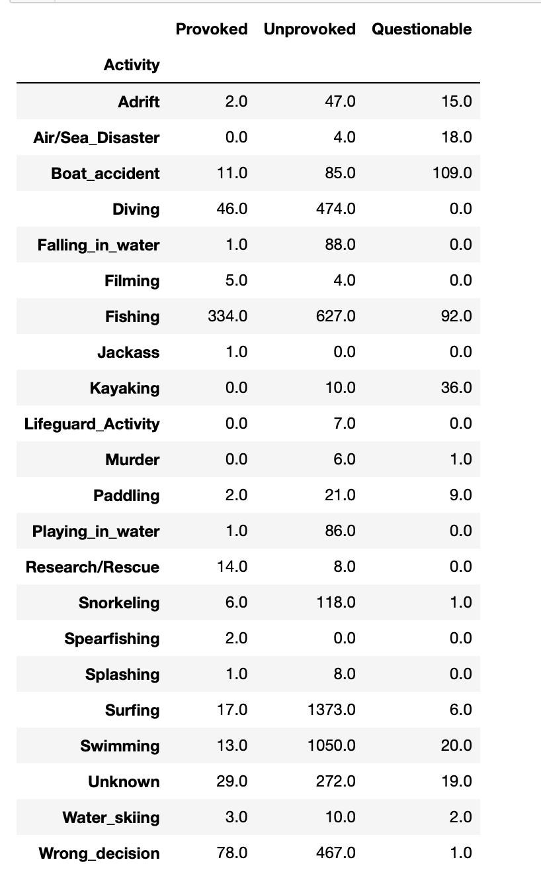
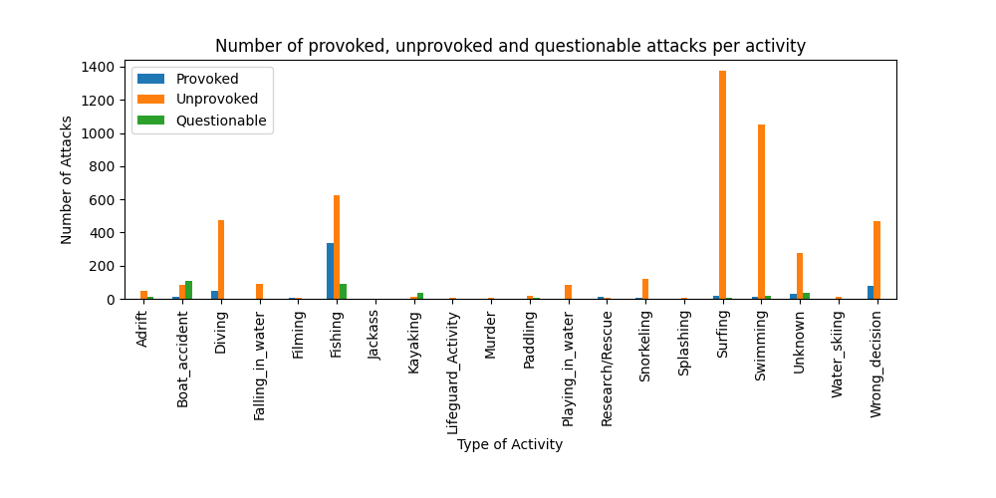
Lyudmila
Global Shark Attack File (GSAF) defines a provoked incident as one in which the shark was speared, hooked, captured or in which a human drew "first blood".
We know that a live human is rarely perceived as prey by a shark. Many incidents are motivated by curiosity, others may result when a shark perceives a human as a threat or competitor for a food source, and could be classed as "provoked" when examined from the shark's perspective.
Notes:
Lyuda

Slide 12
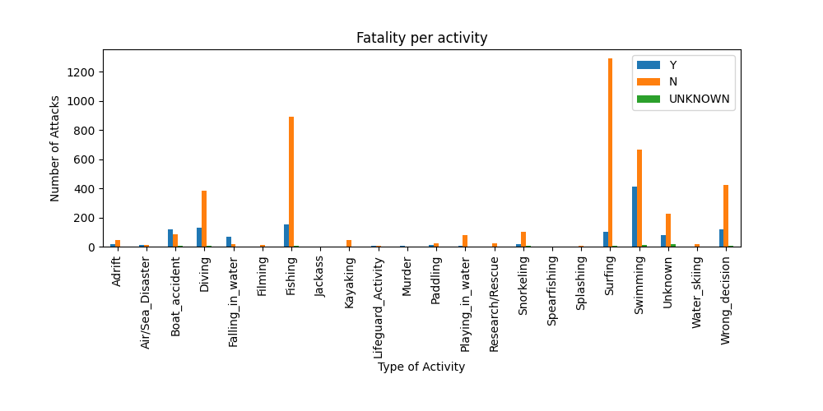
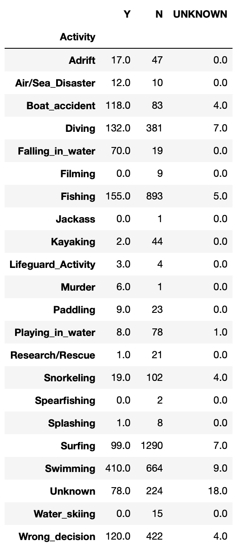
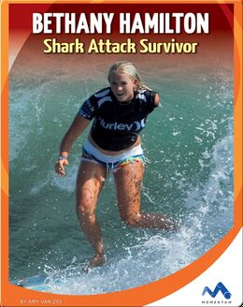
Many incidents result because, like other animals that don't rely on instinct alone, sharks explore their environment.
Lacking hands, they may investigate an unfamiliar object with their mouths.
Notes:
Lyuda

Slide 13
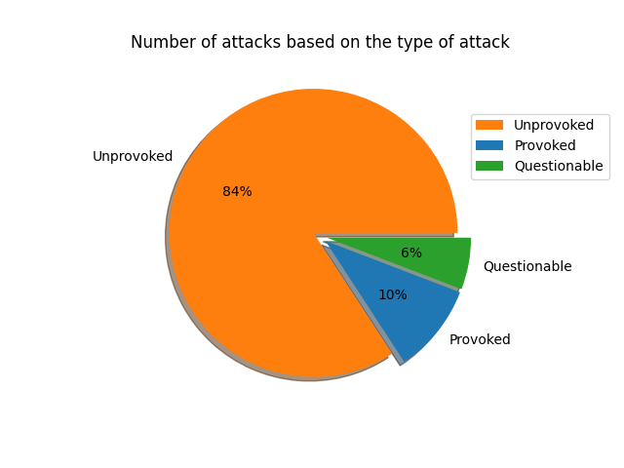
Questionable incidents - Incidents in which there are insufficient data to determine if the injury was caused by a shark or the person drowned and the body was later scavenged by sharks. In a few cases, despite media reports to the contrary, evidence indicated there was no shark involvement whatsoever.
Notes:
Lyuda

Slide 14
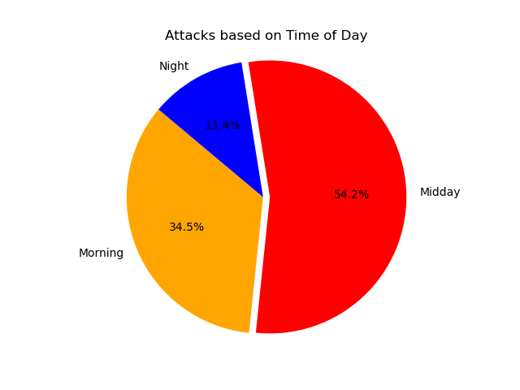
Conclusion: Based on the data provided, more than half of the reported shark attacks happen during the day, most likely due to this being the time period where majority of people prefer to be around water.
Notes:
Tadeo

Slide 15
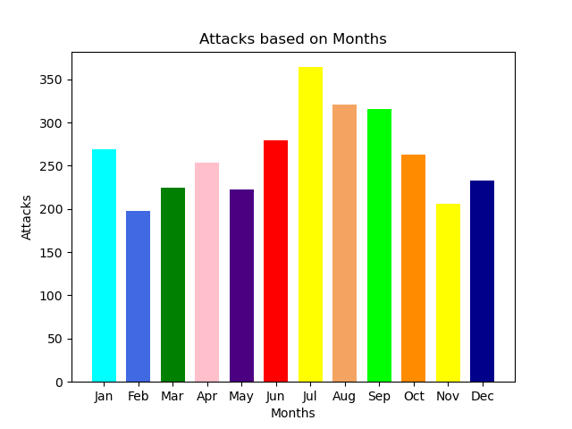
Conclusion: Based on the data provided, it seems that the warmest months are the ones that have the most attacks.
Notes:
Tadeo

Slide 16
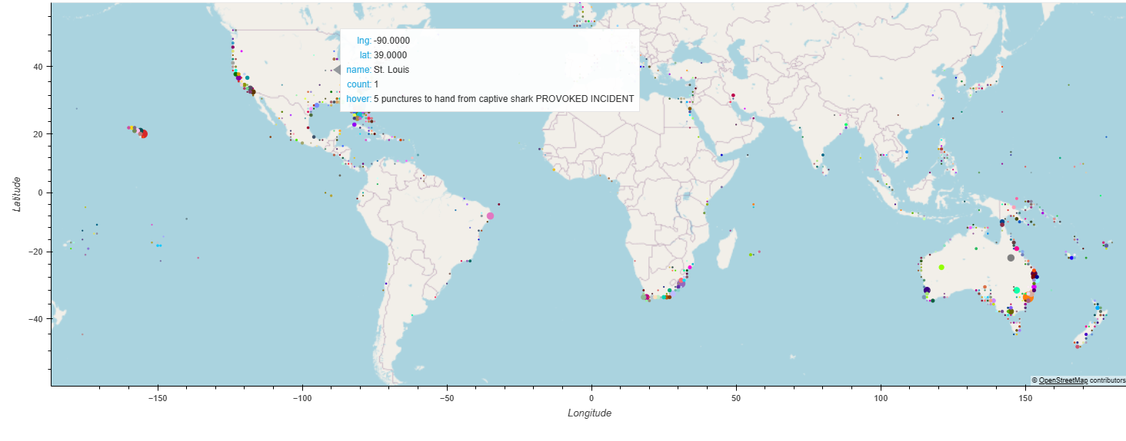
Location
Where do sharks attack?
Notes:
Owen

Slide 17
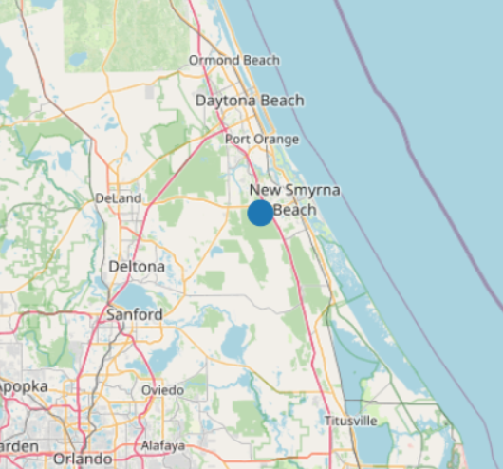
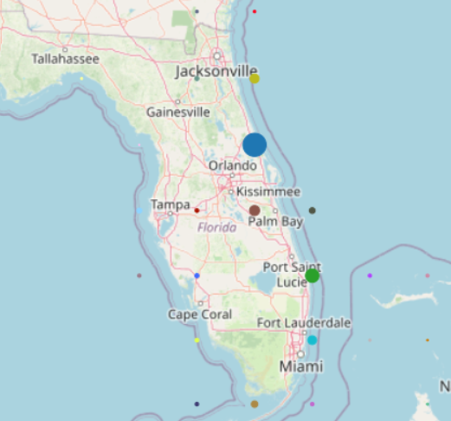
New Smyrna Beach
Shark Bite Capital of the World
Notes:
Owen

Slide 18
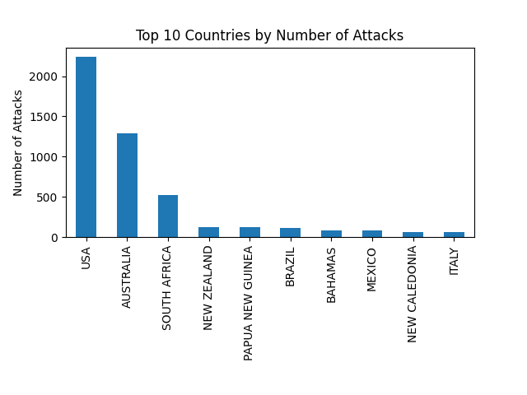
Possible Causes
Higher shark population
More people in water
Specific water conditions
Careless/stupid people
Notes:
Owen

Slide 19
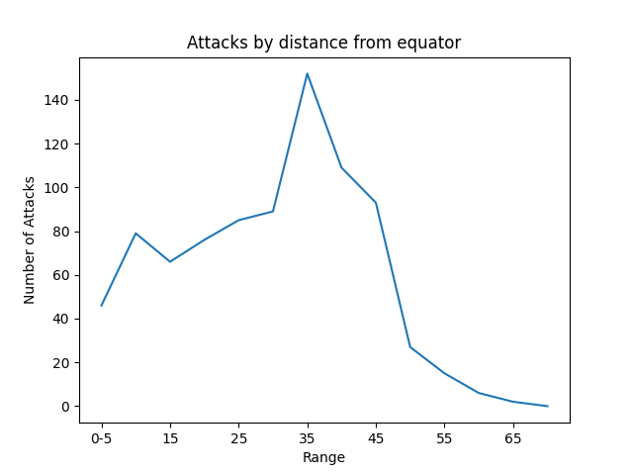
Conclusions
The majority of shark attacks take place in the ocean in warm waters - subtropical zones (25-35°) lead the way with tropical zones not far behind (<25).
Notes:
Owen

Slide 20
How to avoid being attacked by a shark
Overview
How to act
Temperature
Sharks live in the ocean; humans do not.
The data suggests that the simplest way to avoid being attacked by a shark is to stay out of their environment. That’s especially true for men, as men are attacked far more than women.
The majority of reported shark attacks are unprovoked; it’s not enough to just be nice to them.
Certain activities are associated with more attacks, so – if you are in waters that may have sharks – it is advised to minimize activities that could excite sharks, such as splashing at the surface.
Several of our conclusions associate shark attacks with warmer temperatures: attacks are more common in warm months, in the middle of the day, and in warmer climates.
Take extra care when around water during the warmer parts of the year.
Notes:
Kelsey

Slide 21
Further research opportunities
Sex disparities
Activities
Temperature
Why do sharks attack men more? Are men more likely to participate in activities that attract sharks? Do men spend more time in the water? Has the disparity changed over time as women’s rights have improved?
Does the data show activities that attract sharks lead to more attacks, or does the data just show the most common activities human engage in within a shark’s habitat?
Are there activities that keep sharks away?
Are sharks more likely to attack in warm weather, or is that just the most likely place for humans and sharks to cross paths? Are people as likely to be attacked by sharks in colder waters, but – because people spend less time in cold water – the data is skewed?
Notes:
Kelsey

